Slide 1
Warfighter Refractive Eye Surgery Program
Pre-Operative Brief
1
Committed To Those We Serve

Slide 2
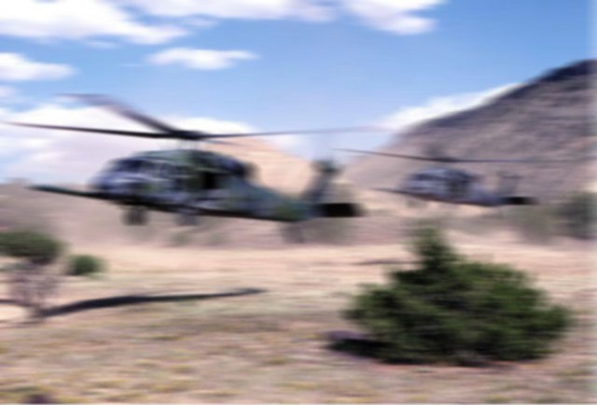

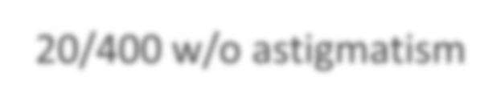

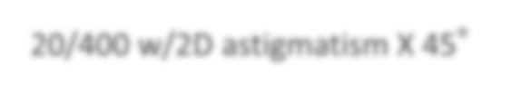
Why offer refractive surgery?
20/400 w/o astigmatism
Soldiers need to see!
20/400 w/2D astigmatism X 45°
2
Committed To Those We Serve

Slide 3
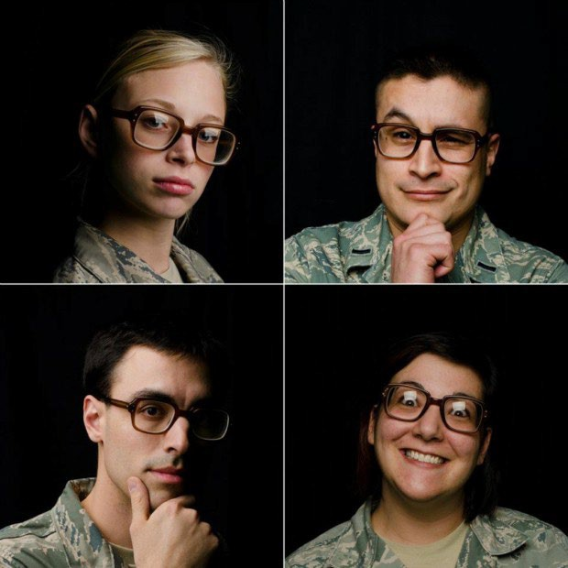
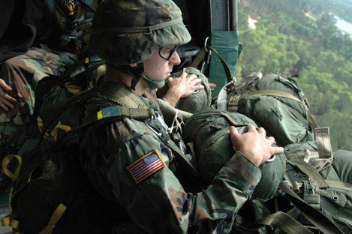
Spectacles have limitations
Can get lost / misplaced / broken / never ordered!
Can slide down your nose with sweat
Can fog up at the worst times
Can get knocked off in combat

Slide 4
Army Refractive Surgery
Established at Ft. Bragg in 2000, now in 14 locations
Nearly 250,000 treatments performed since inception
25,000 procedures per year Army wide
All centers are state-of-the-art with advanced laser platforms

Slide 5
Refractive Eye Surgery Options
PRK (Photorefractive Keratectomy)
LASIK (Laser Assisted In-Situ Keratomileusis)
ICL (Implantable Contact Lens)
Clear Lens Exchange (replace natural lens with artificial one)
You may also:
Remain the way you are (do nothing/specs and contacts)
Change your mind at anytime until the laser starts

Slide 6

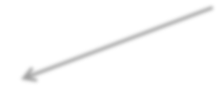
The Cornea
The cornea is the clear tissue at the front of your eye that you see through – where you put your contact lens
Epithelium: laser energy is not effective here
Stroma: laser energy has a permanent effect here
Front View
Cross-section View
For a lasting correction, the laser needs to be applied to the stroma, but the epithelium is in the way!

Slide 7
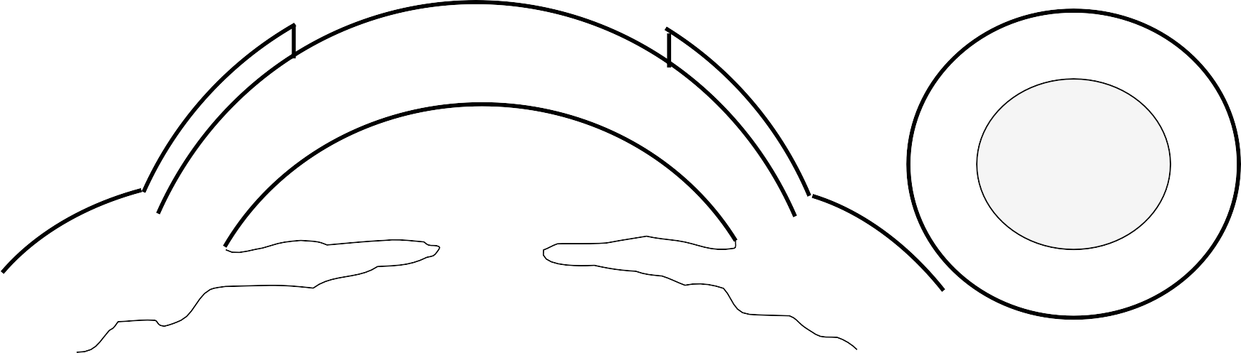
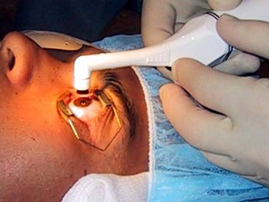
PRK
In PRK, the epithelium is removed with a circular brush.

Slide 8






PRK
Second, the laser removes tissue to reshape the eye.

Slide 9
PRK Post-op
Third, a bandage contact lens is placed on the eye to reduce post- operative pain.

Slide 10
PRK End Result
One week later, the bandage contact lens is removed. Cornea is flatter and thinner, but otherwise looks as if you never had surgery.

Slide 11
LASIK
Starts with the same anatomy as PRK, but in LASIK the surgeon just moves the epithelium rather than removes it.

Slide 12

LASIK Flap Creation
The epithelium, or skin, is too fragile to move by itself without tearing, so a flap is created from stroma and skin
Hinge Point
Flap is cut with a laser. It is disk-shaped, like a man-hole cover, except it
remains connected at one point (the hinge).
12
Committed To Those We Serve

Slide 13
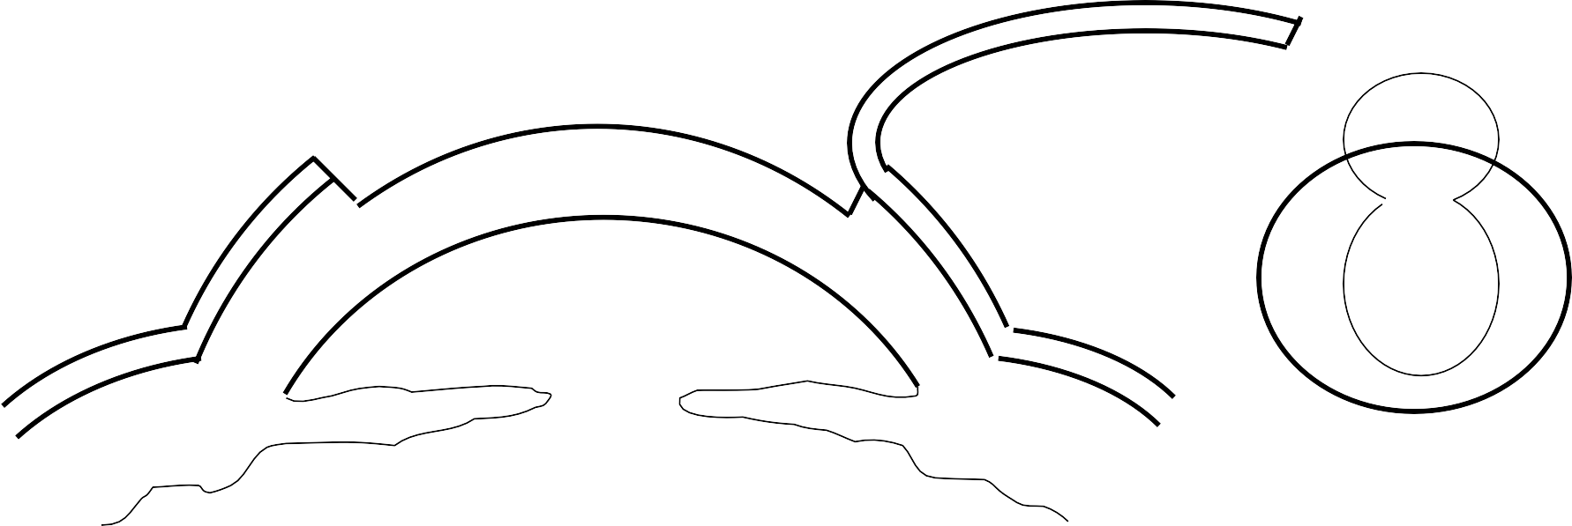
LASIK Flap Lift
A tool can then be inserted to break any remaining adhesions / connect the perforations. The flap is lifted, exposing stroma.
13
Committed To Those We Serve

Slide 14






LASIK
The laser treatment is identical to PRK.
14
Committed To Those We Serve

Slide 15
LASIK
The flap is repositioned and smoothed out. The eye is inspected to make sure there is no debris under flap and there are no folds are in the flap. Flap settles into position over the next several
days.
15
Committed To Those We Serve

Slide 16

Who makes a good candidate?
Presenter Notes
2025-08-21 23:07:36
--------------------------------------------
5-10% do not qualify for any surgery
Correction is stable
No underlying eye conditions (glaucoma, cataracts, corneal dz)
Normal medical history and medication use
(particularly as it relates to poor wound healing)
No predisposing risk factors of bad outcomes:
  Thin corneas
  Warping of cornea (ectasia / keratoconus)
  Dry eye
  Large pupils
  Trauma, prior eye infections or prior eye surgery

Slide 17
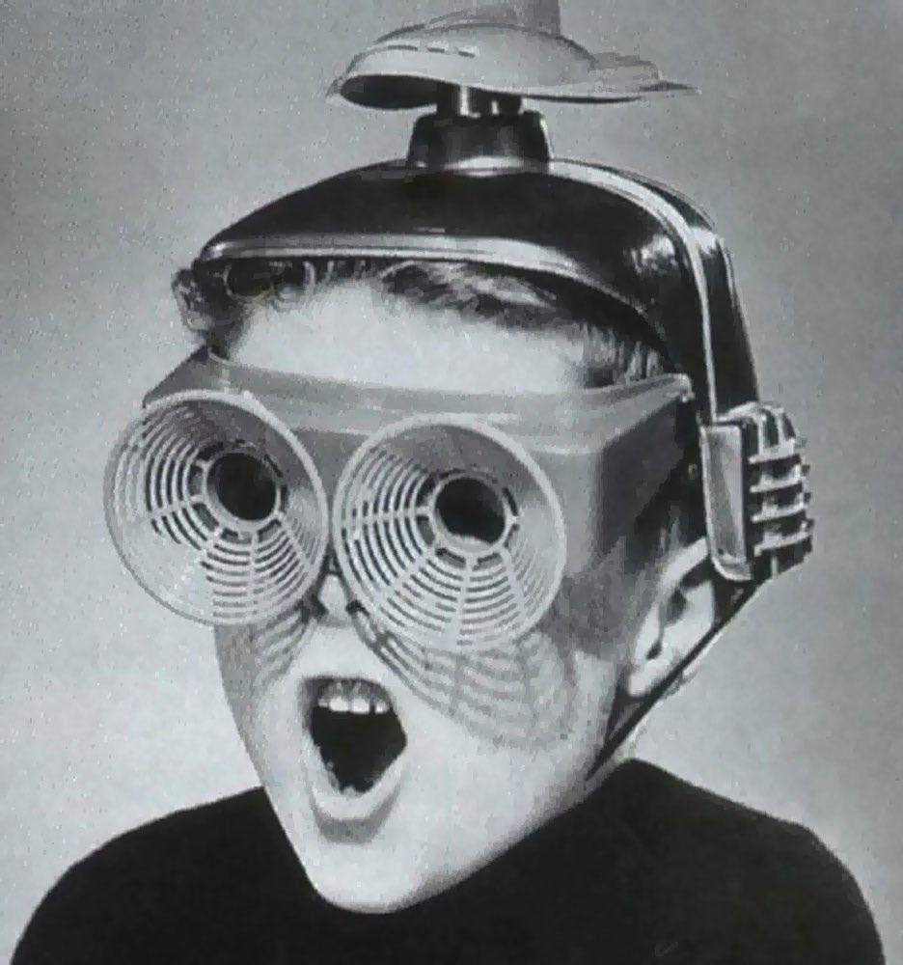
How will I see after surgery?

Slide 18











What are the risks?
These are irreversible SURGICAL procedures
There are RISKS associated with the procedures
Realistic expectations are necessary

Slide 19
Post Laser Refractive Surgery
After either PRK or LASIK you will experience some problems with your eyes… these are usually mild and temporary, but may become permanent and debilitating.
Specifically, these include:
  Pain
  Dry Eye
  Light Sensitivity
  Blur
  Glare
  Halos
  Starbursts
  Double Vision
19
Committed To Those We Serve

Slide 20

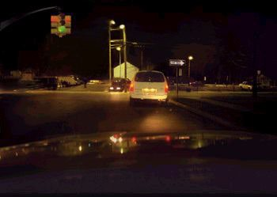
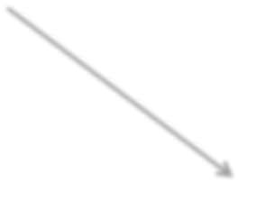

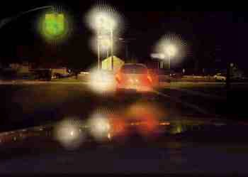

Post-op Visual Aberrations
Glare / Halo surrounding a point source of light at night
Starbursts, often seen with a soft halo, usually at night
20
Committed To Those We Serve

Slide 21
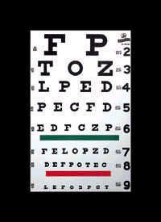
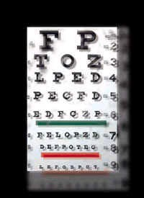
Post-op Visual Aberrations
“Double vision” or “ghosting” of images
21
Committed To Those We Serve

Slide 22
Post-op Regression
Presenter Notes
2025-08-21 23:07:37
--------------------------------------------
Outlaw josey wales—post-op squinting?
The laser treatment is permanent
  But with time you may need to wear glasses again
  The crystalline lens changes shape over time
  Presbyopia in your 40s

Slide 23
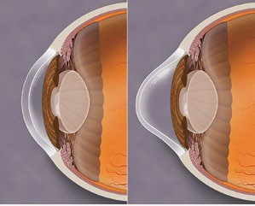
Post-op Ectasia
Some corneas are prone to warp, causing blurry vision, surgery would worsen this – no-go for surgery
Even under the best screening programs, ectasia or warping can still occur

Slide 24
Post-op Pain and Infection
For PRK, pain usually worst at day 2-3. Don’t plan on doing a lot of visually demanding work the first week
For LASIK there is less pain post-op. You may have bleeding or bruising on the eye.
In either case, infection can be visually devastating!
  Signs of infection include: worsening vision, increasing redness, increased pain (or there is significant asymmetry between eyes)
  If you suspect a problem, come to the clinic ASAP as a walk-in for an urgent exam!

Slide 25


















Limitations of Refractive Surgery
Our goal is to enhance soldier readiness and battlefield performance by REDUCING your dependency on corrective lenses
Surgery does NOT eliminate the need for glasses.
  Eye Protection / Eye Armor
  Sunglasses (UV Protection)
  Reading glasses when >45 years old
– Thin glasses to fine tune vision for some patients
25
Committed To Those We Serve

Slide 26
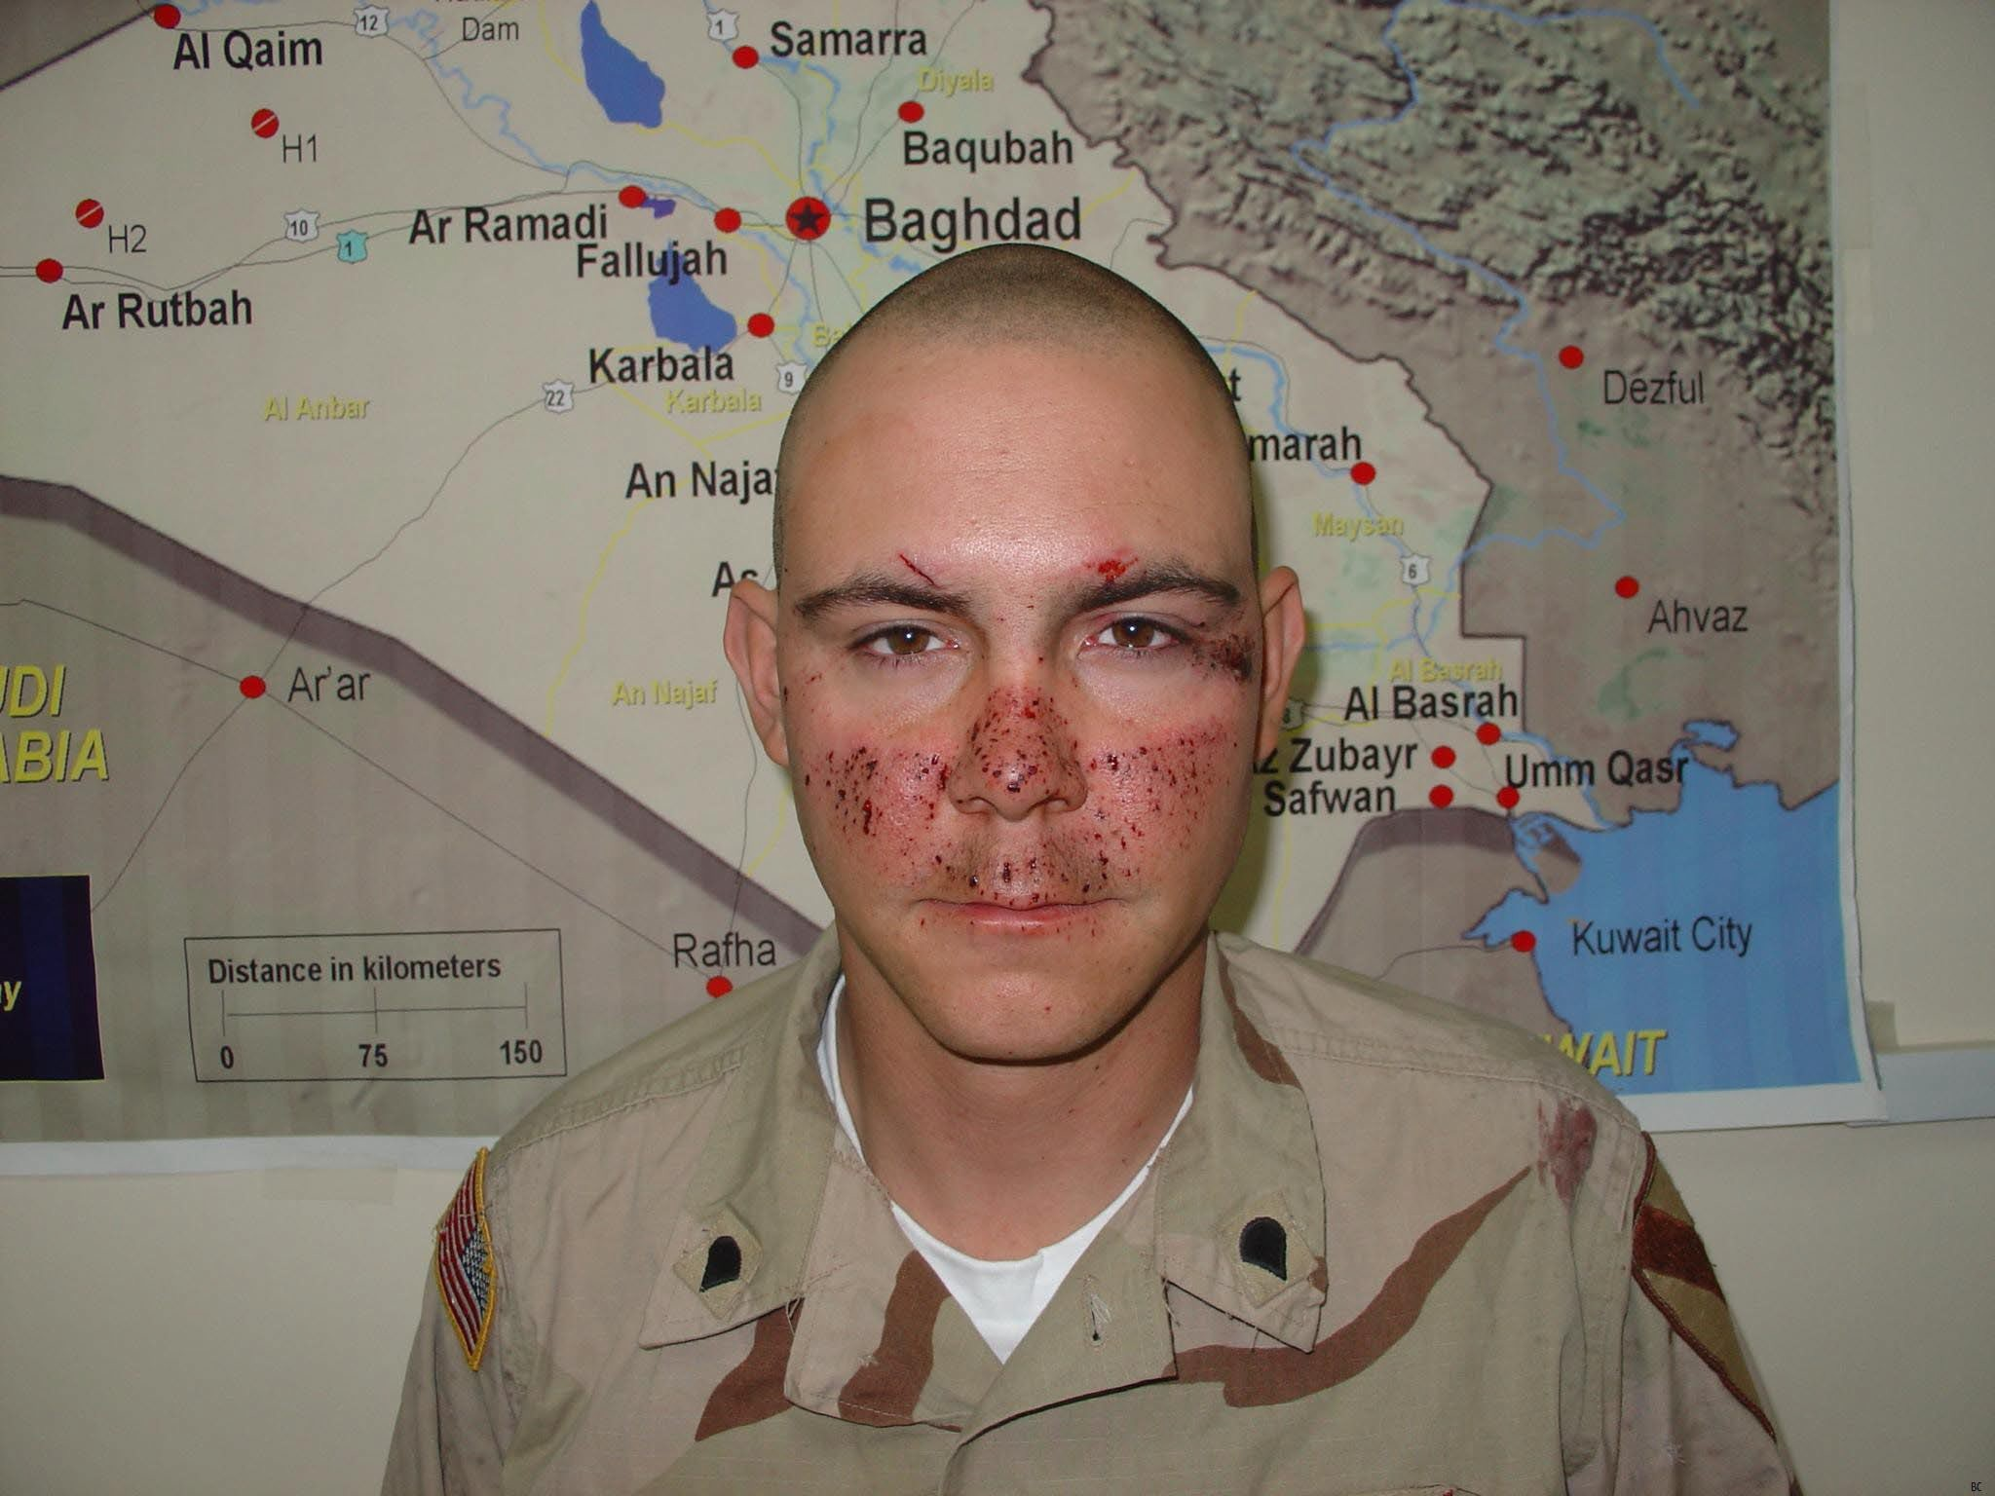
Limits: Eye Protection

Slide 27
Limits: Expectations
Common Misconceptions:
Everyone who has refractive surgery will achieve perfect 20/15 vision
If I’m 20/20 after refractive surgery, my vision will be perfect
If I’m not 20/20 after surgery, I will be unhappy

Slide 28



















Military Criteria
Units commanders authorize soldiers to apply
No flags or adverse personnel actions pending
Con leave for the day of surgery +5 days
Non-deployable and a temporary profile for one month
Non-deployable to CENTCOM AO for 3 months
Air Force needs Special Approval
Waiver for HALO / SCUBA

Slide 29








Follow-up Appointments
1 Day
1 Week
1 Month
3, 6, and 12 months
If you are from out of town and have made arrangements for a local optometrist to remove your bandage contact lens, a co- management agreement will need to be signed and on file before we can perform surgery on you.

Slide 30
Specific PRK Pro / Con
Disadvantages:
  Discomfort – big scratch to eye, expect to use narcotics
  Haze – can blur vision and cause glare, mitigated by drops and UV sunglasses (you have to take your meds!)
  Slow recovery – skin is rough at first, so blurry; must be replaced with smoother skin 2-3 times to get final clarity
Advantages:
  One surgical procedure, no flap to cut
  Faster and requires less cooperation from patient
  Anatomically, it’s as close to your pre-op eye as possible, more stable and in most cases trauma does not affect it

Slide 31
Specific LASIK Pro / Con
Disadvantages:
  Two procedures, more delicate, need more cooperation
  Until the flap is sealed down, a poke to the eye could require a return to the laser suite
Advantages:
  Less pain, typically an ache or scratchy feeling for a few days
  Fast recovery – driving in 1-2 days, back to full duty in 2-3d
  Better visual outcomes for some patients; easy to re-treat

Slide 32
Questions
Please write down any questions you may have and bring them to your appointment to discuss with your provider.

